Slide 1
Osher Lifelong Learning Institute, Winter 2024
Contemporary Economic Policy
University of Cincinnatti
January-Februarey 2024
Jon Haveman, Ph.D.
National Economic Education Delegation

Slide 2
National Economic Education Delegation
Vision
  One day, the public discussion of policy issues will be grounded in an accurate perception of the underlying economic principles and data.
Mission
  NEED unites the skills and knowledge of a vast network of professional economists to promote understanding of the economics of policy issues in the United States.
NEED Presentations
  Are nonpartisan and intended to reflect the consensus of the economics profession.

Slide 3
Who Are We?
Honorary Board: 54 members
  2 Fed Chairs: Janet Yellen, Ben Bernanke
  6 Chairs Council of Economic Advisers
    Furman (D), Rosen (R), Bernanke (R), Yellen (D), Tyson (D), Goolsbee (D)
  3 Nobel Prize Winners
    Akerlof, Smith, Maskin
Delegates: 652+ members
  At all levels of academia and some in government service
  All have a Ph.D. in economics
  Crowdsource slide decks
  Give presentations
Global Partners: 48 Ph.D. Economists
  Aid in slide deck development

Slide 4


Where Are We?

Slide 5
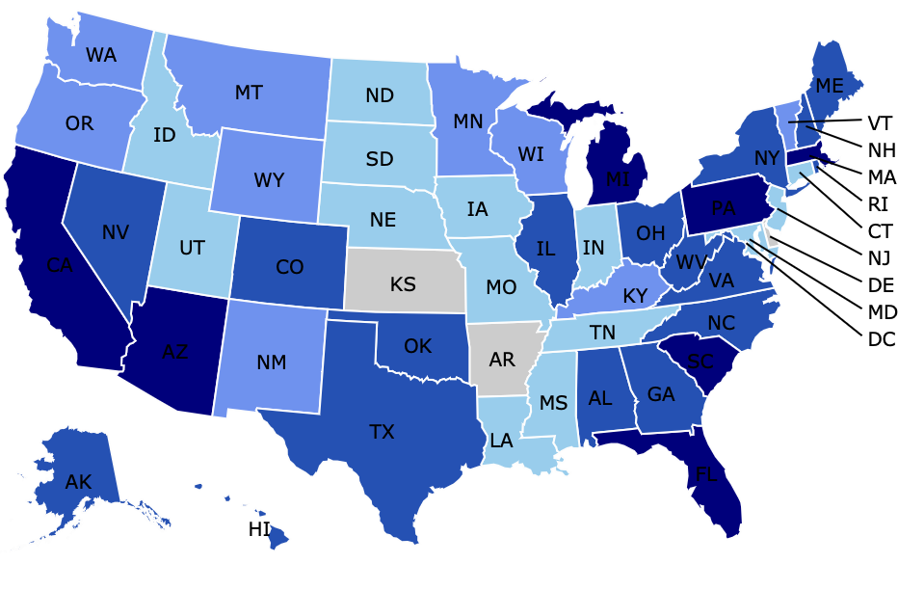
Where Have we Given Talks?

Slide 6
Available NEED Topics Include:
US Economy
Healthcare Economics
Climate Change
Economic Inequality
Economic Mobility
Trade and Globalization
Minimum Wages
Immigration Economics
Housing Policy
Federal Budgets
Federal Debt
Black-White Wealth Gap
Autonomous Vehicles
US Social Policy

Slide 7
Course Outline
Contemporary Economic Policy
  Week 1 (1/24): Economic Update (Geoffrey Woglom Amherst College)
  Week 2 (1/31): Economic Inequality (Geoffrey Woglom)
  Week 3 (2/7): Economic Mobility (Kathryn Wilson Kent State U))
  Week 4 (2/14): Discrimination in U.S. Policy History (Jon Haveman NEED))
  Week 5 (2/21: The Black-White Wealth Gap (Jon Haveman)

Slide 8

The Abrupt Increase in Inequality
Source: Chad Stone, Danilo Trisi, Arloc Sherman, and Roderick Taylor, “A Guide to Statistics on Historical Trends in Income Inequality,”
Center on Budget and Policy Priorities, Policy Futures, Dec. 11, 2018.
Notes:
Slide taken from page 10, Chad Stone, Danilo Trisi, Arloc Sherman, and Roderick Taylor, “A Guide to Statistics on Historical Trends in Income Inequality,” May 15, 2018

Slide 9
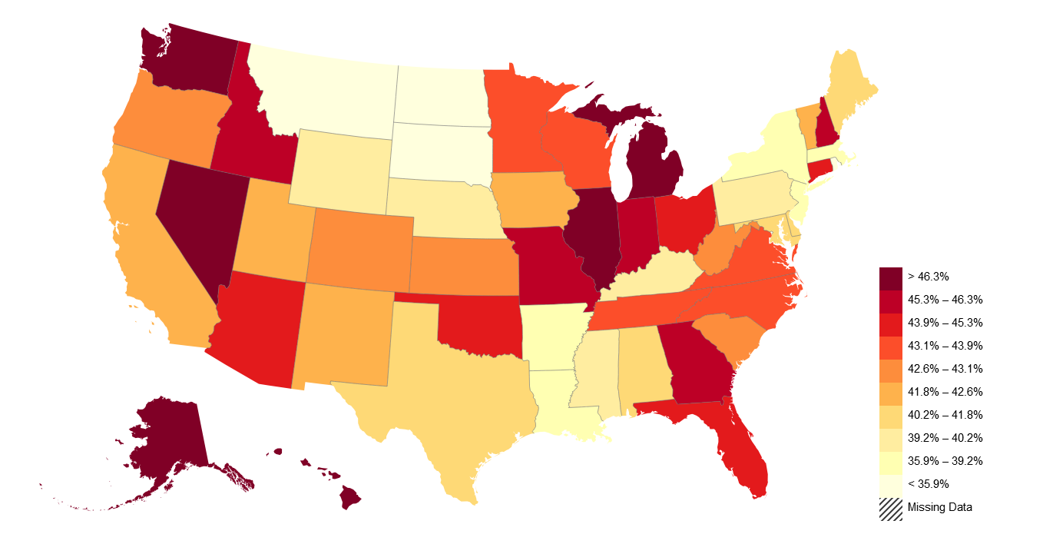
American Dream: Geography Matters
II. Empirical Patterns of Economic Mobility
Trends in Absolute Mobility by State: Change from 1940-1980
Decline in Abs. Mob. from 1940-80
https://opportunityinsights.org/paper/the-fading-american-dream/

Slide 10
Misguided Past Policies: Redlining
Red areas were largely
Black communities,
and considered to be too risky
for new home loans.
Yellow areas also suffered from discrimination resulting from FHA guidelines.

Slide 11
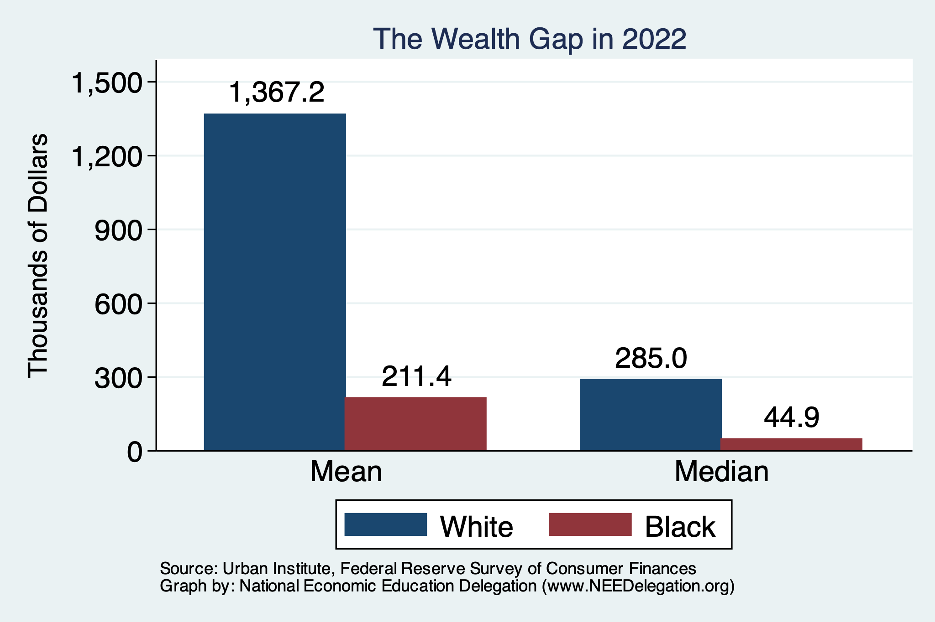
Evidence of the Gap
Mean is
6.5x Greater
Median is 6.3x Greater

Slide 12
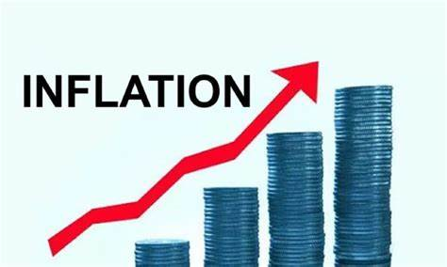
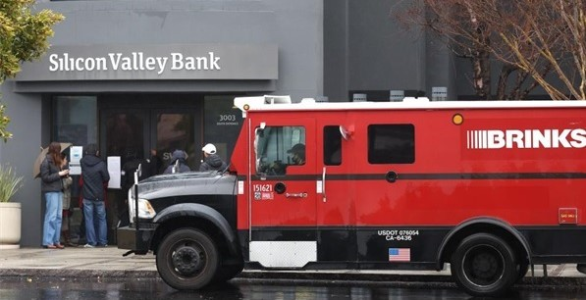
US Economy: Update
Geoffrey Woglom,
Professor of Economics
Amherst College, emeritus
January 24, 2024

Slide 13
Credits and Disclaimer
This slide deck was authored by:
  Jon D. Haveman, NEED
  Scott Baier, Clemson University
  Geoffrey Woglom, Amherst College (Emeritus)
  Brian Dombeck, Lewis & Clark College
  Doris Geide-Stevenson, Weber State
Disclaimer
  NEED presentations are designed to be nonpartisan.
  It is, however, inevitable that the presenter will be asked for and will provide their own views.
  Such views are those of the presenter and not necessarily those of the National Economic Education Delegation (NEED).

Slide 14
Outline for the Talk
Summary of the state of the macroeconomy.
The Effect of M&F policies on the recovery.
Explain why there was a major change in the outlook on 11/1.
Describe an unprecedented monetary policy achievement that may be unfolding

Slide 15
Gross Domestic Product
Consumption | 67.8%
Investment | 17.7%
Exports | 11.0%
Imports | -13.8%
Government | 17.3%
GDP | 100.0%

Slide 16
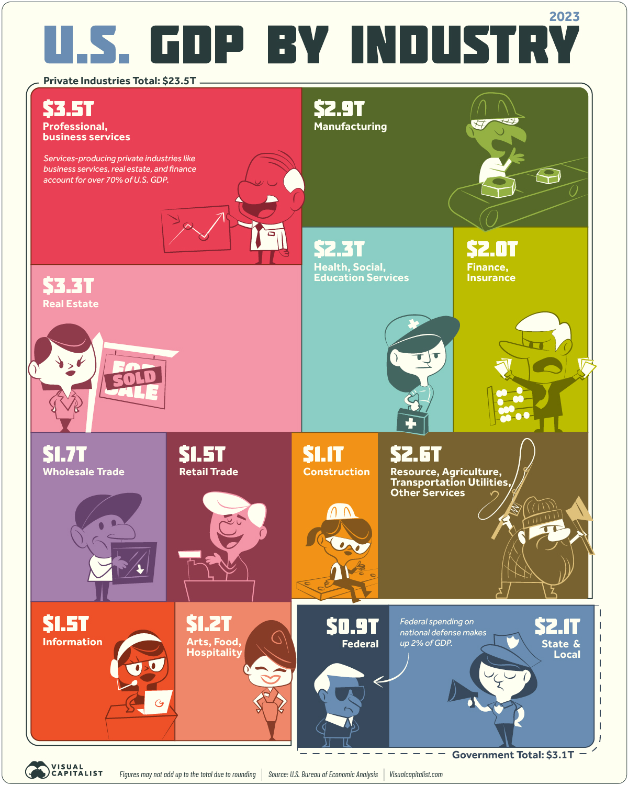
Different Breakdown
Note: State and Local Government comprises 10% of GDP!

Slide 17
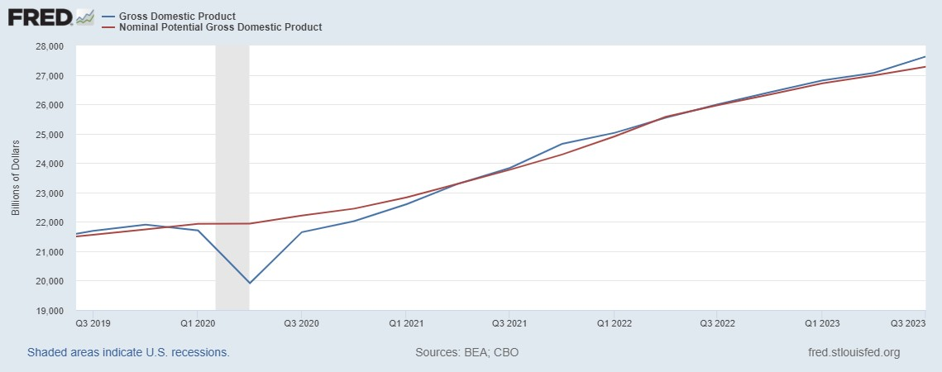
GDP and ‘Potential’ during the Recovery
Grey bars are recessions
Source: Fred, St Louis Fed

Slide 18
Unemployment is Near Record Lows

Slide 19
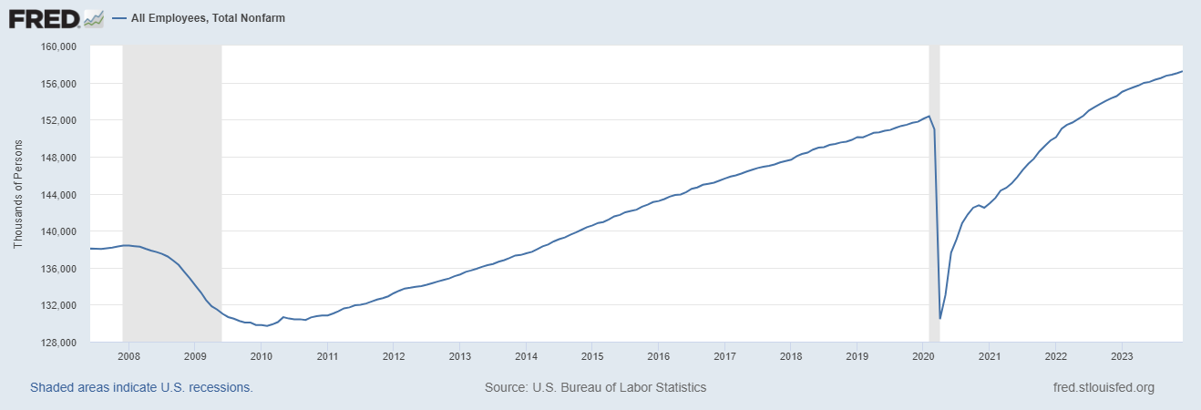
Where Have All the Workers Gone?
Notes:
Largely explained by baby boomer retirements and a little excess retirements due to COVID

Slide 20
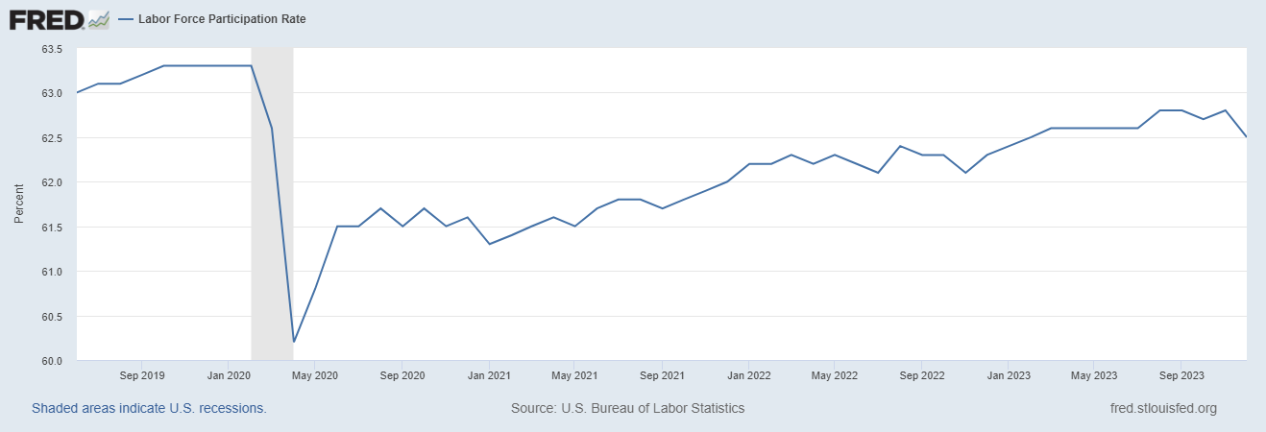
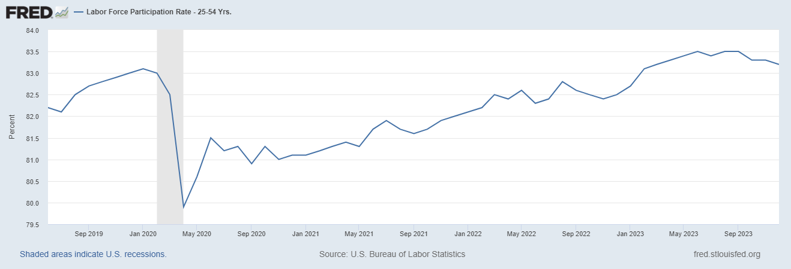
The Great Resignation?
Notes:
CBO Jan 2020 projections: LF, 62.5, vs 62.6; Total employment; 154.8 million vs actual 155.6. Civilian Labor Force; 160 vs 166.7

Slide 21
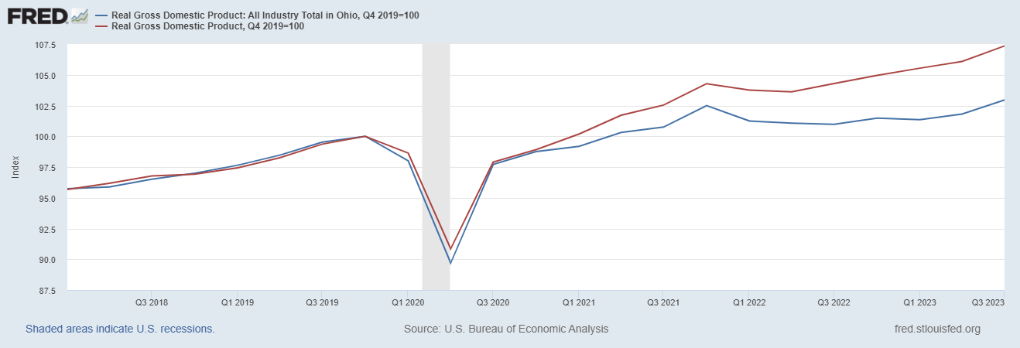
How is Ohio Doing?

Slide 22
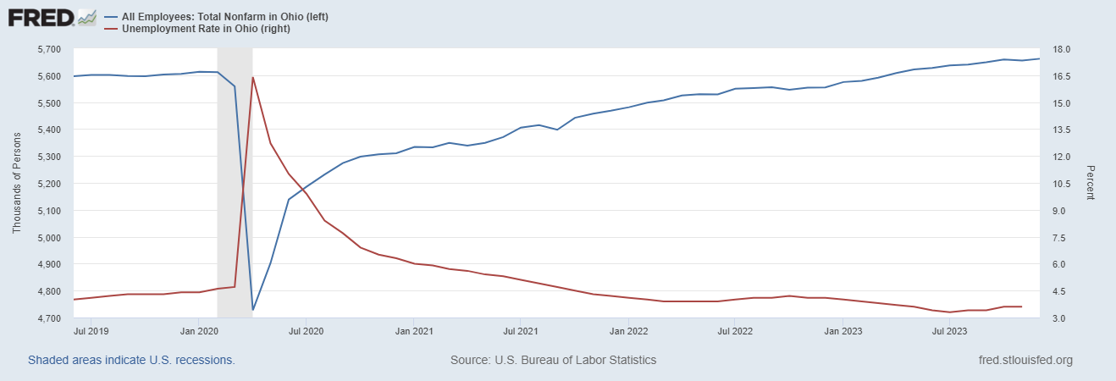
Labor Market in Ohio
Notes:
Ohio 1% increase in employment vs. 3% nationally

Slide 23
Overall Good News on the Real Side
GDP is very close to its potential.
The labor market as measured by the unemployment rate is fully recovered.
There was no apparent Great Resignation
But there is also a nominal side: interest rates, asset prices, inflation and wages.
News isn’t so good, but is getting better.

Slide 24
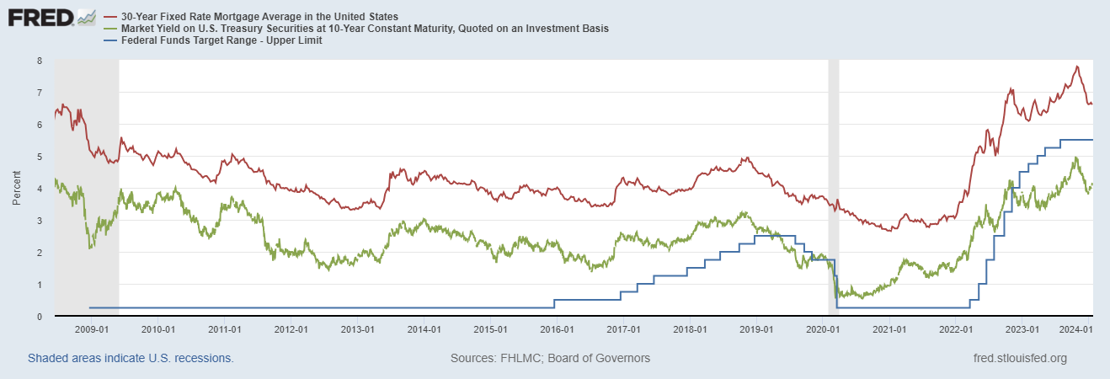
Interest Rates: Era of Falling Rates Over?
Notes:
Fed policy rate 4.5 to 4.25. Concerns with inflation

Slide 25
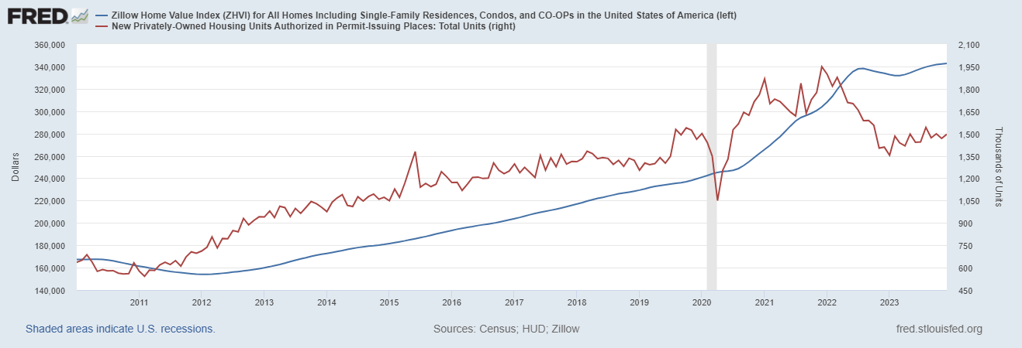
Mortgage Rates are Having an Effect ?

Slide 26
National Housing Market and Closer to Home
https://www.zillow.com/research/data/

Slide 27
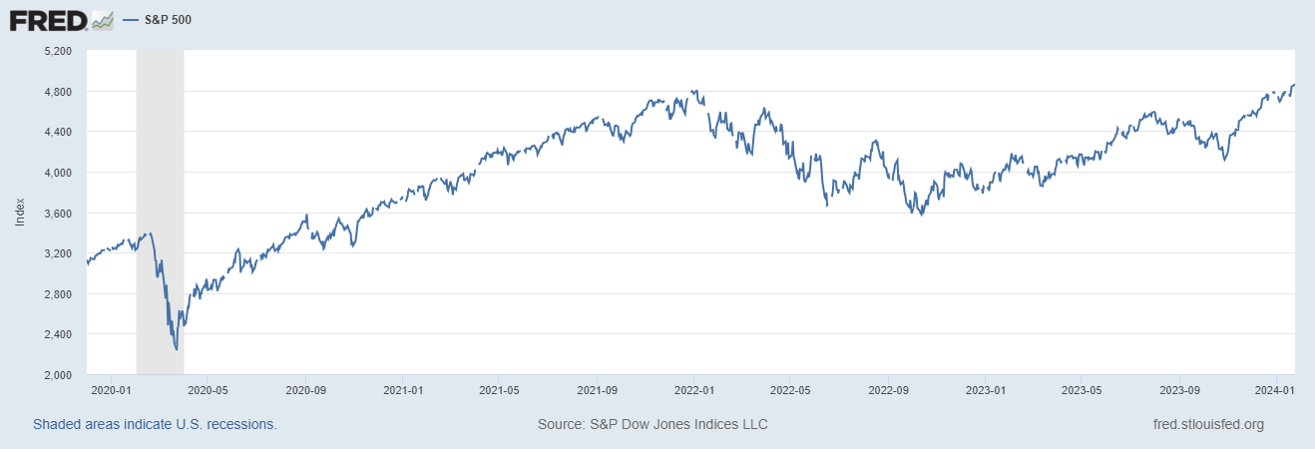
Stock Prices: Fear Giving Way to Greed?
Notes:
Since the end of 2021, lost almost 15%

Slide 28
Inflation during the Recovery (CPI)
Notes:
August CPI yoy 8.3% down from 8.5 and Core 6.3 up from 6.3 in JUly

Slide 29
Fed’s Measure (PCE)
Fed Doesn’t React until 3/2022
Looks Promising?

Slide 30
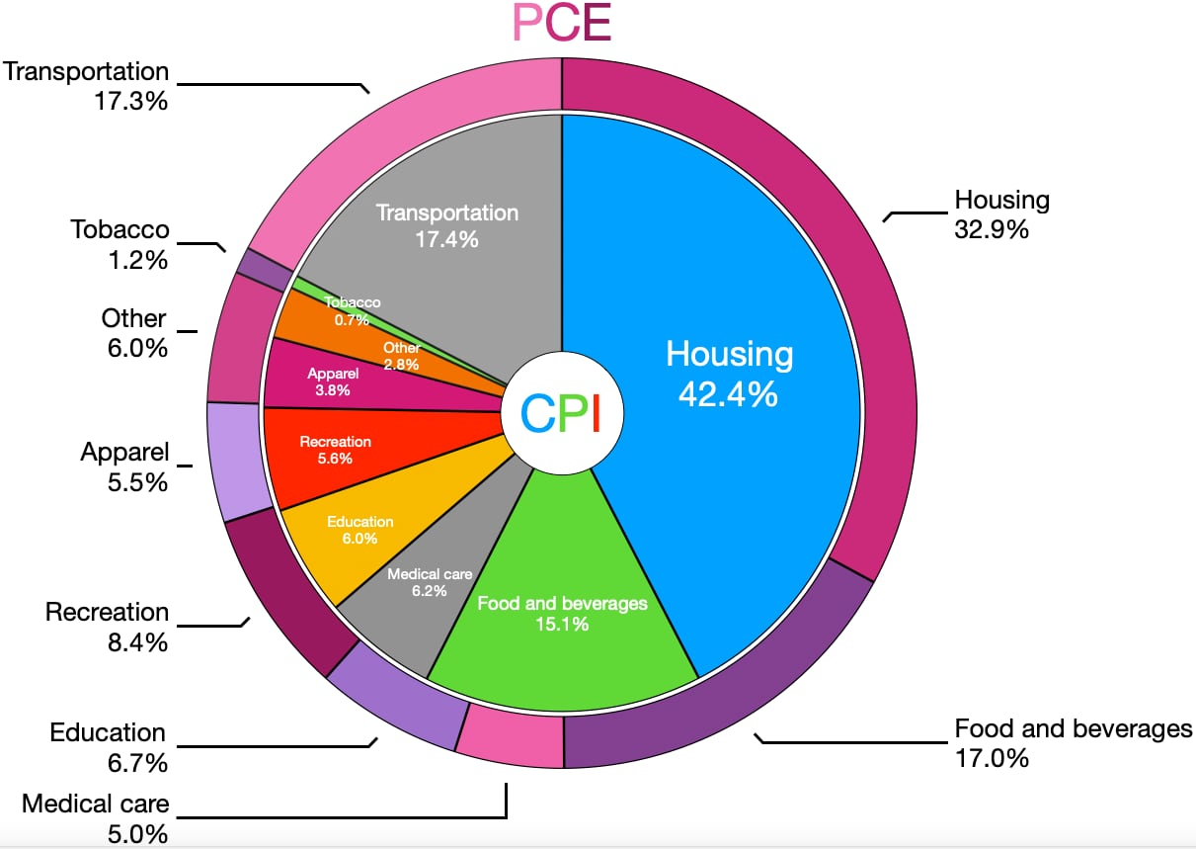
CPI vs. PCE: Differences
CPI tends to be higher (Nov):
CPI, 3.1%
PCE, 3.4%
Core CPI, 4.0%
Core PCE, 3.2%.
Typically more like 0.5 % pts.
https://en.wikipedia.org/wiki/Personal_consumption_expenditures_price_index#

Slide 31
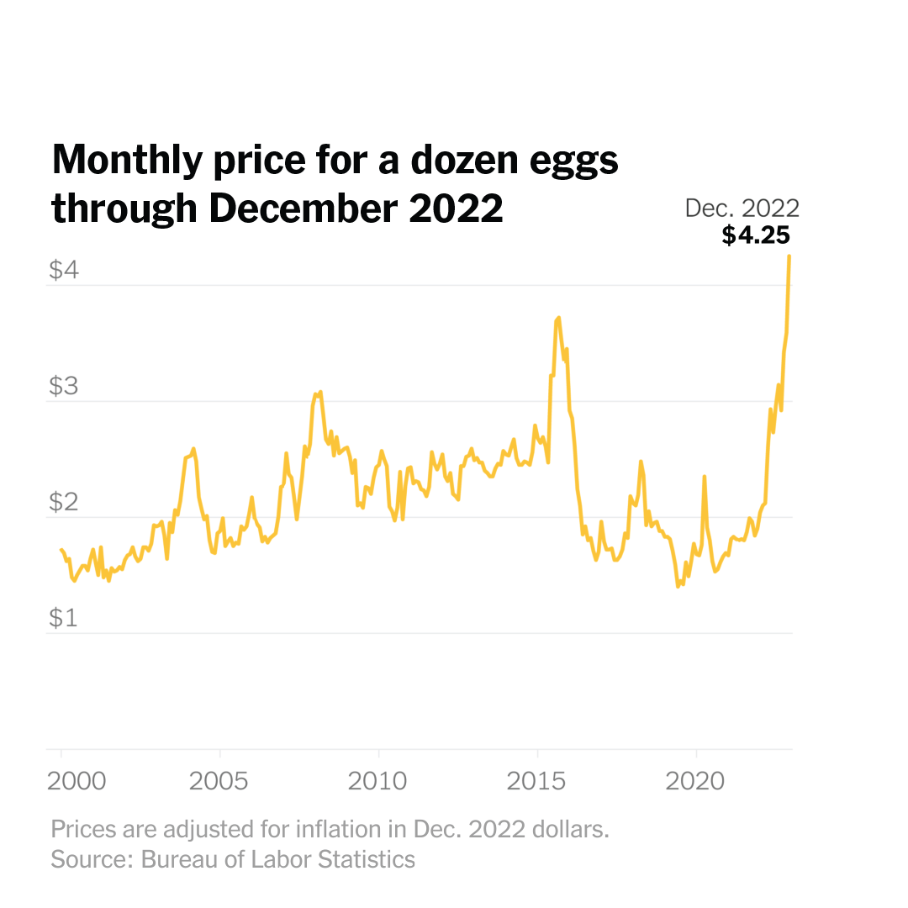
Uses of Inflation Measures
Two Reasons for Measuring Recent Inflation:
What has happened to the Cost of Living?
What is likely to happen to inflation over the next 12-18 months?

Slide 32
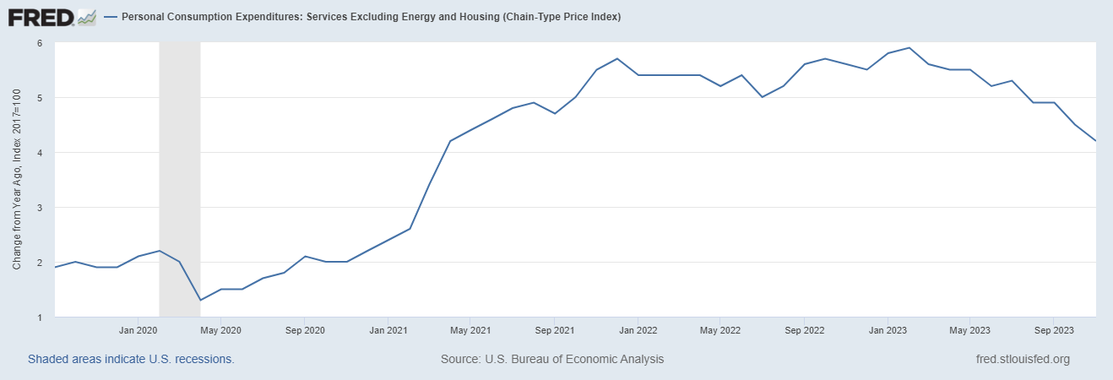
Measuring “Underlying” Inflation
Super Core

Slide 33
What is Special about Measuring Over 1 Year?

Slide 34
Rents Paid versus Asking Rents

Slide 35
Wages Haven’t Kept Pace with Inflation, Yet
Notes:
But, note that low wage workers are doing relatively the best

Slide 36
The “Nominal” Side
Inflation: There is still work to be done, but things are looking much better.

Slide 37
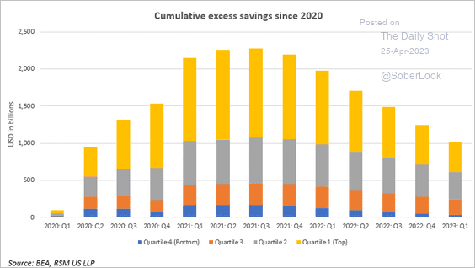
Policy Effects: Fiscal
2020-2021: massive stimulus, $4.6t: Cares Act, 3 rounds of stimulus checks, expanded unemployment benefits, Payroll Protection Loans.

Slide 38
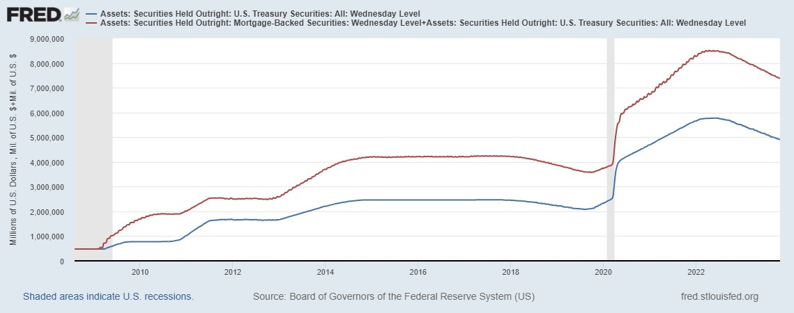
Policy Effects: Monetary
2020-2/2022: policy interest rate at zero, new round of quantitative easing.
3/2022-present: most rapid increase in interest rates since Paul Volcker

Slide 39
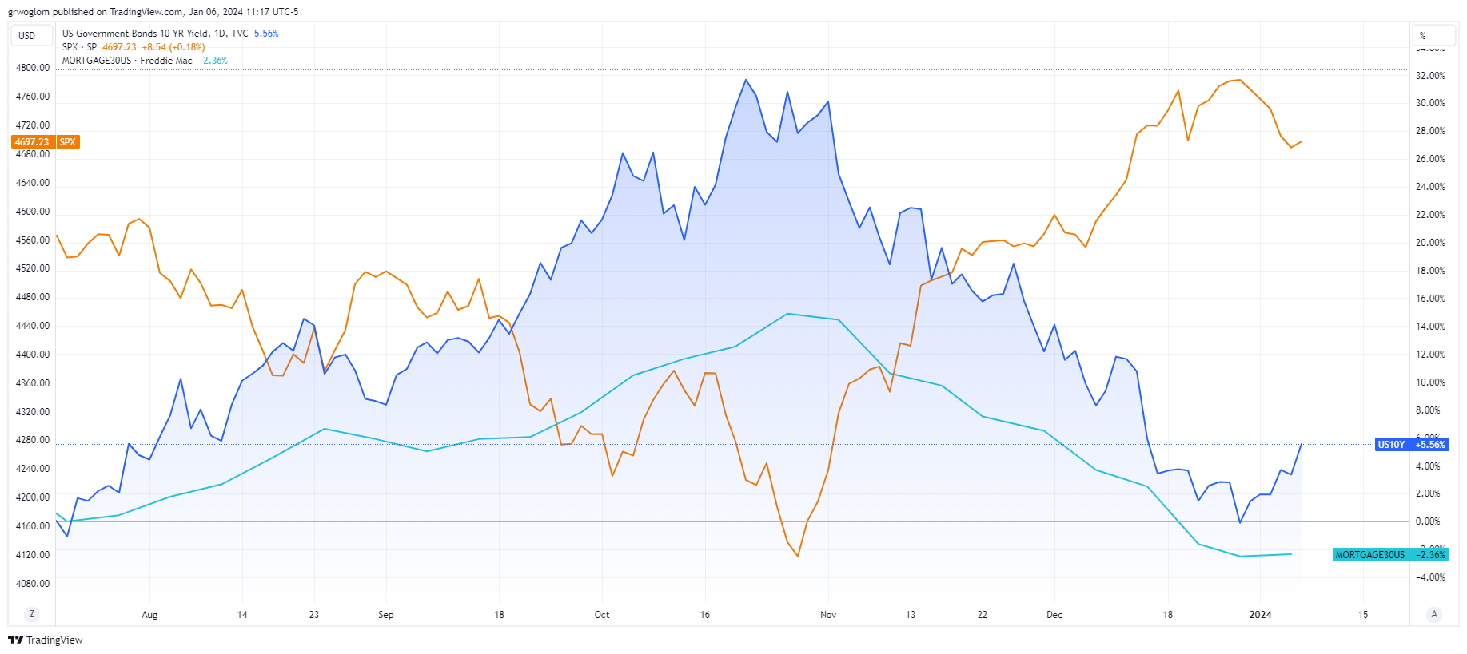
What Happened on 11/1?

Slide 40
Not Much: Changes in the Policy Statement

Slide 41
Fed’s Evolving Views on the Economy
November Survey of Professional Forecasters very similar outlook
Austin Goolsbee, President of the Chicago Fed. The economy is on a “golden path” and will achieve the “mother of all soft landings.”
How did this happen?

Slide 42
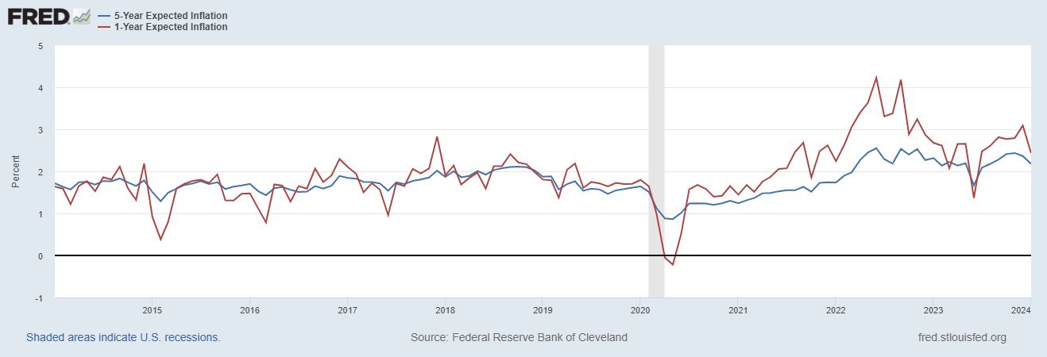
Long-Term Inflation Expectations Remained “Well Anchored”

Slide 43
What will the Fed Do (In an Election Year!)?
Current and Pending Developments:
Tomorrow (8:30) BEA announces 4th Quarter and annual GDP for 2023.
Friday, PCE for December
January 30/31 next Fed meeting
Notes:
GDPNow 2.4%; blue chips consensus 1.5% implies 2.9%, or 2.7%

Slide 44
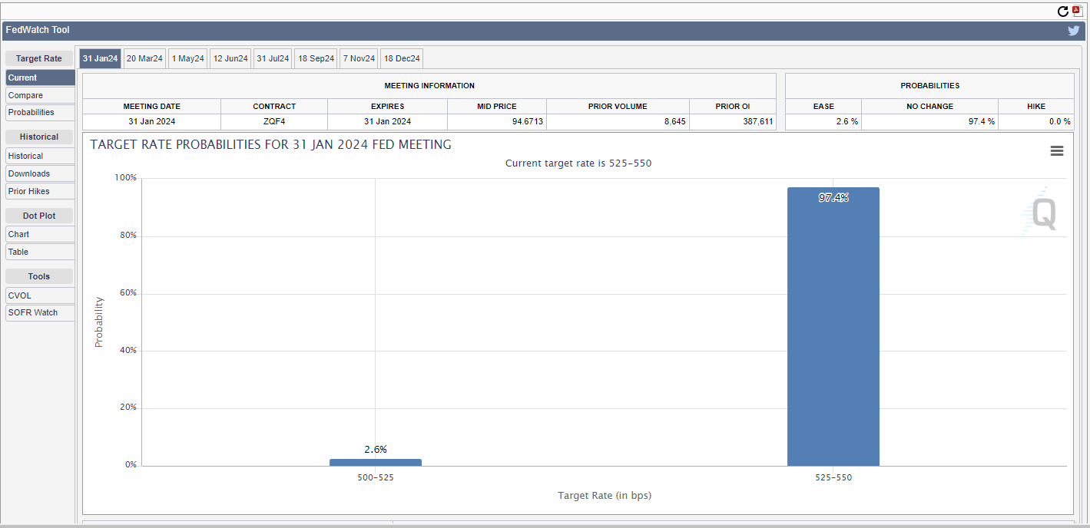
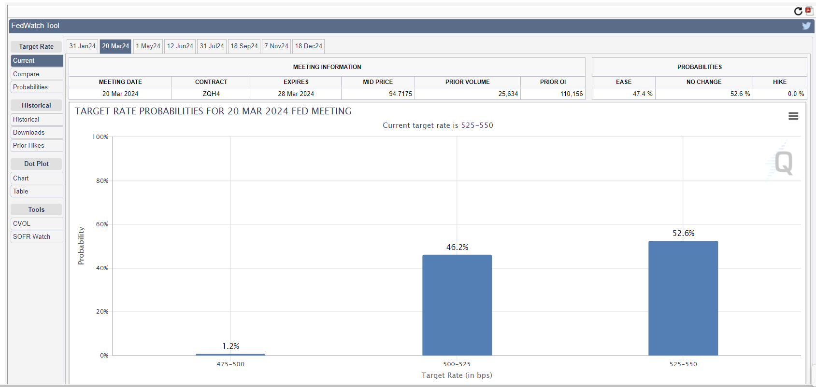
Here is What the Market Thinks
https://www.cmegroup.com/markets/interest-rates/cme-fedwatch-tool.html

Slide 45
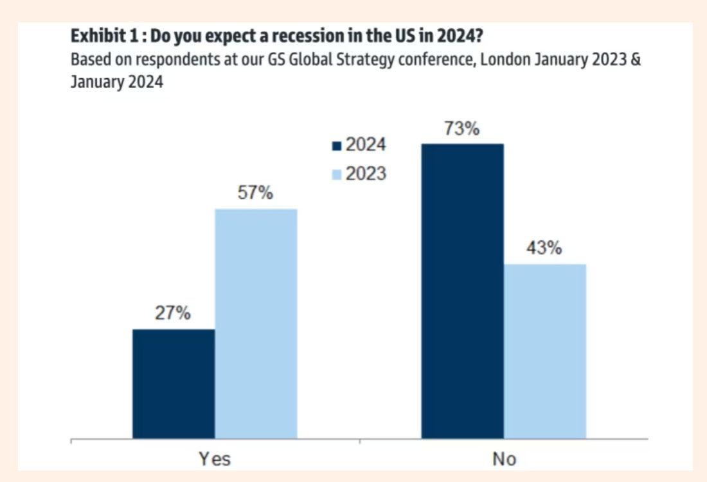
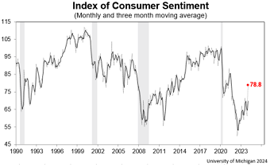
Where Will the Economy Be in November?

Slide 46
The Abrupt Increase in Inequality
Source: Chad Stone, Danilo Trisi, Arloc Sherman, and Roderick Taylor, “A Guide to Statistics on Historical Trends in Income Inequality,”
Center on Budget and Policy Priorities, Policy Futures, Dec. 11, 2018.
Notes:
Slide taken from page 10, Chad Stone, Danilo Trisi, Arloc Sherman, and Roderick Taylor, “A Guide to Statistics on Historical Trends in Income Inequality,” May 15, 2018

Slide 47
Let’s Hear from You!
Geoffrey Woglom grwoglom@amherst.edu
Contact NEED: Info@NEEDEcon.org
Submit a testimonial: www.NEEDEcon.org/testimonials.php
Support NEED: www.NEEDEcon.org/donate.php

